Slide 1
Synaptic integration in single neurons
Tiago Branco

Slide 2
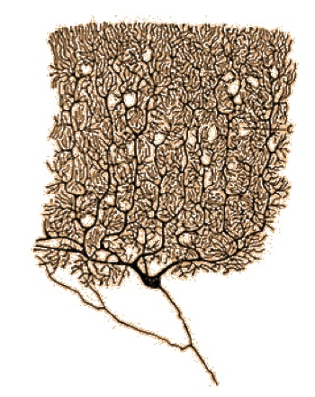
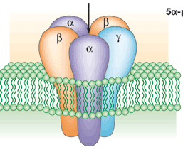
Model
Neuron
Molecules
dV_{i}
τ
=
–(V_{i} – V_{rest}) + Σ_{j} w_{ij} g_{j}(t)
dt

Slide 3
Why do we care?

Slide 4

Input-output function of single neurons
dV
C
=
g_{syn}(V_{syn} – V_{rest})
dt

Slide 5
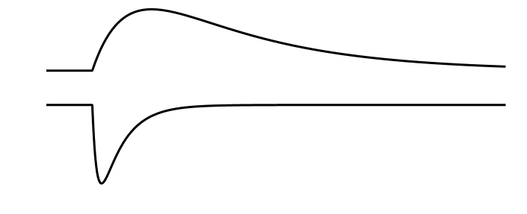
Synaptic conductance and currents
Single synapses are weak and brief
2 ms
1 nS
65 pA

Slide 6
Equivalent electrical circuit of the membrane
out
R_{N}
C_{N}
V_{rest}
in
Ohm’s law:
V = IR
voltage equals current times resistance
(only at steady state)
At rest, the cell membrane is electrically equivalent to a parallel RC circuit

Slide 7
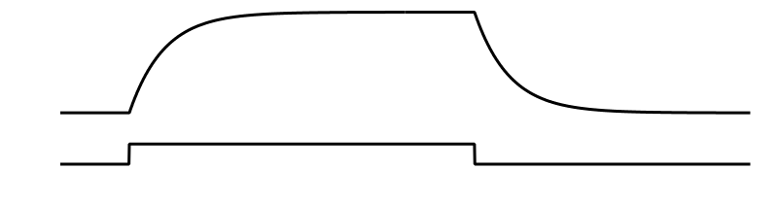
Membrane potential in response to step current
Growing phase
Decaying phase
V
I
time
20 ms
Growing phase:
Decaying phase:
Membrane potential responds to a step current with exponential rise and decay, governed by the membrane time constant,

Slide 8
Membrane potential in response to synaptic current
EPSP decay through resting (leak)
K channels (determined by )
peak of EPSP
EPSP still rising
steepest slope of EPSP
V
I
time
A PSP is slower than a PSC, and its decay is governed by the membrane time constant, .

Slide 9
Membrane potential in response to synaptic current
0.5 mV
V
I
1 nS
2 ms
65 pA

Slide 10
Basic problem
V_{threshold}
20 mV
V_{rest}
Most neurons need to integrate synaptic input to generate action potential output
Integration allows for Computation

Slide 11
How is synaptic input integrated ?
Timing

Slide 12
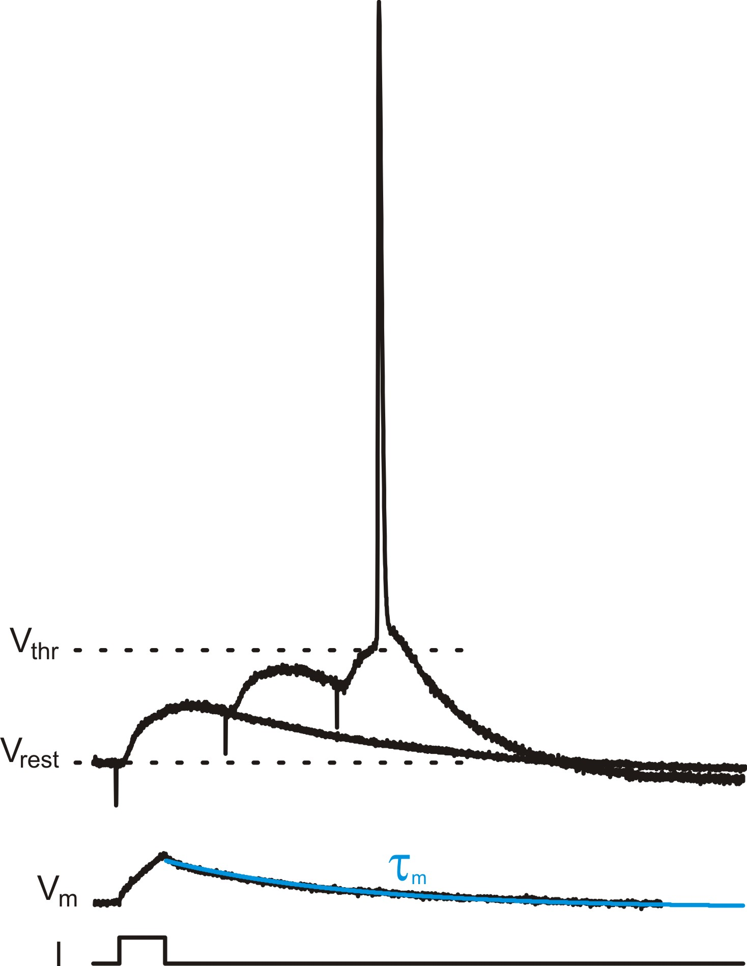
Membrane time constant sets summation time window
Integration
Coincidence detection
M. Scanziani

Slide 13
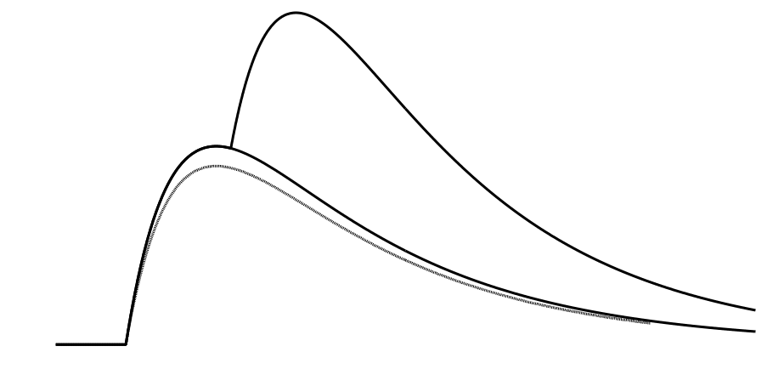
Basic Input-Output function
Linear
Sublinear
excitatory
synapse 2
excitatory
synapse 1
EPSP
1+2
EPSP
1
EPSP
2
by subtraction

Slide 14
Voltage-gated conductances change IO function
dV
C
=
g_{syn}(V_{syn} – V_{rest})
+ g_{Nav}(V_{Nav} – V_{rest}) + g_{Cav}(V_{Cav} – V_{rest}) + g_{Kv}(V_{kv} – V_{rest})
dt

Slide 15
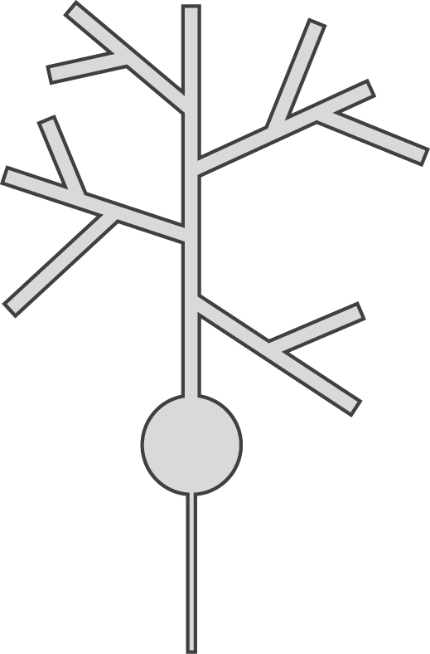
Dendritic trees add a spatial dimension to integration
Timing
Location
Timing

Slide 16
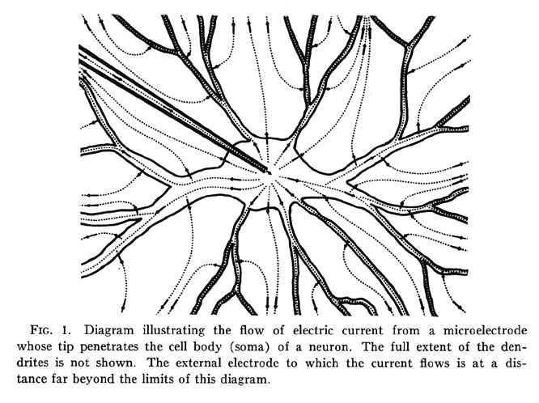
Current flow in neuron with dendrites
Wilfrid Rall
Notes:
Notes:

Slide 17
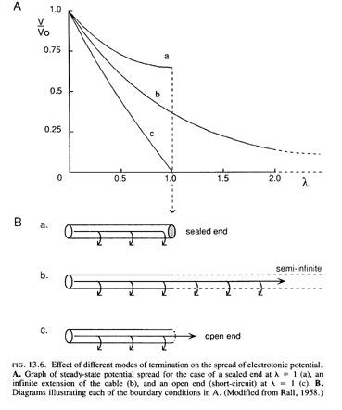

Voltage attenuation in cables
Space constant
R_{m} . d
λ =
R_{i} . 4
Voltage attenuation
V = V₀ e^{-x/λ}
Electrotonic distance

Slide 18
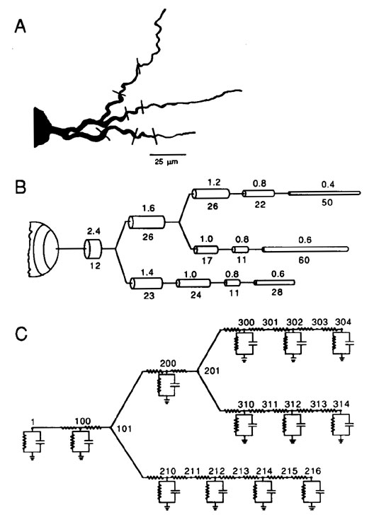
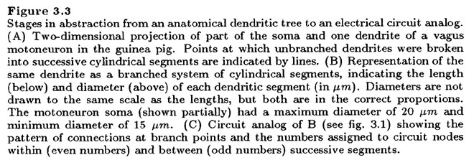
Compartmental modeling of neurons
The NEURON simulation environment
Notes:
Notes:

Slide 19
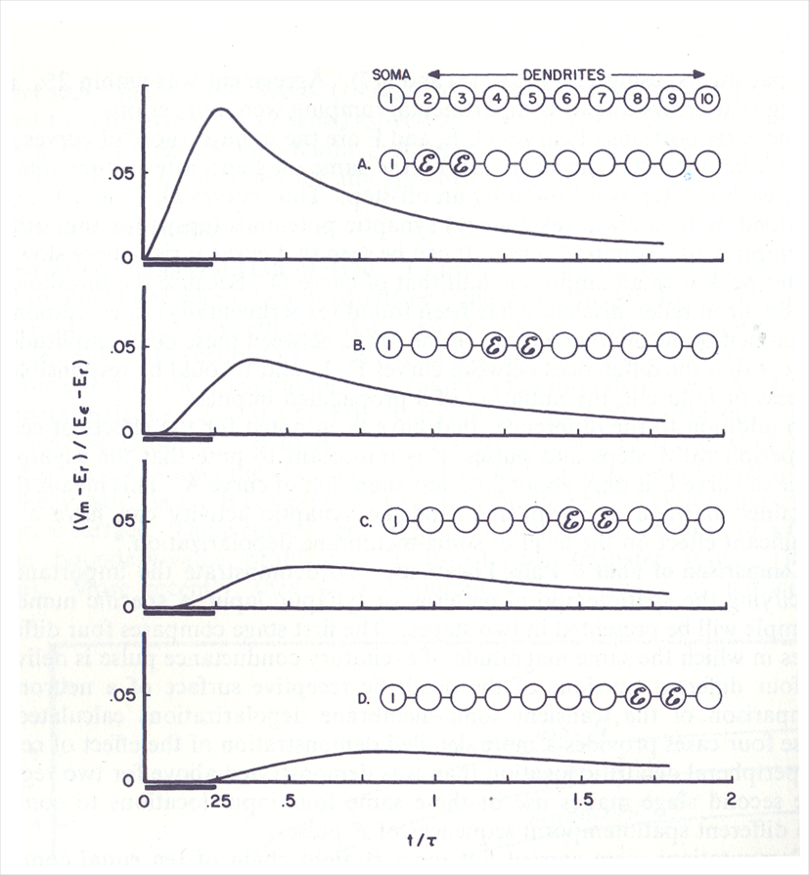
EPSP attenuation by dendrites
Wilfrid Rall, 1964

Slide 20
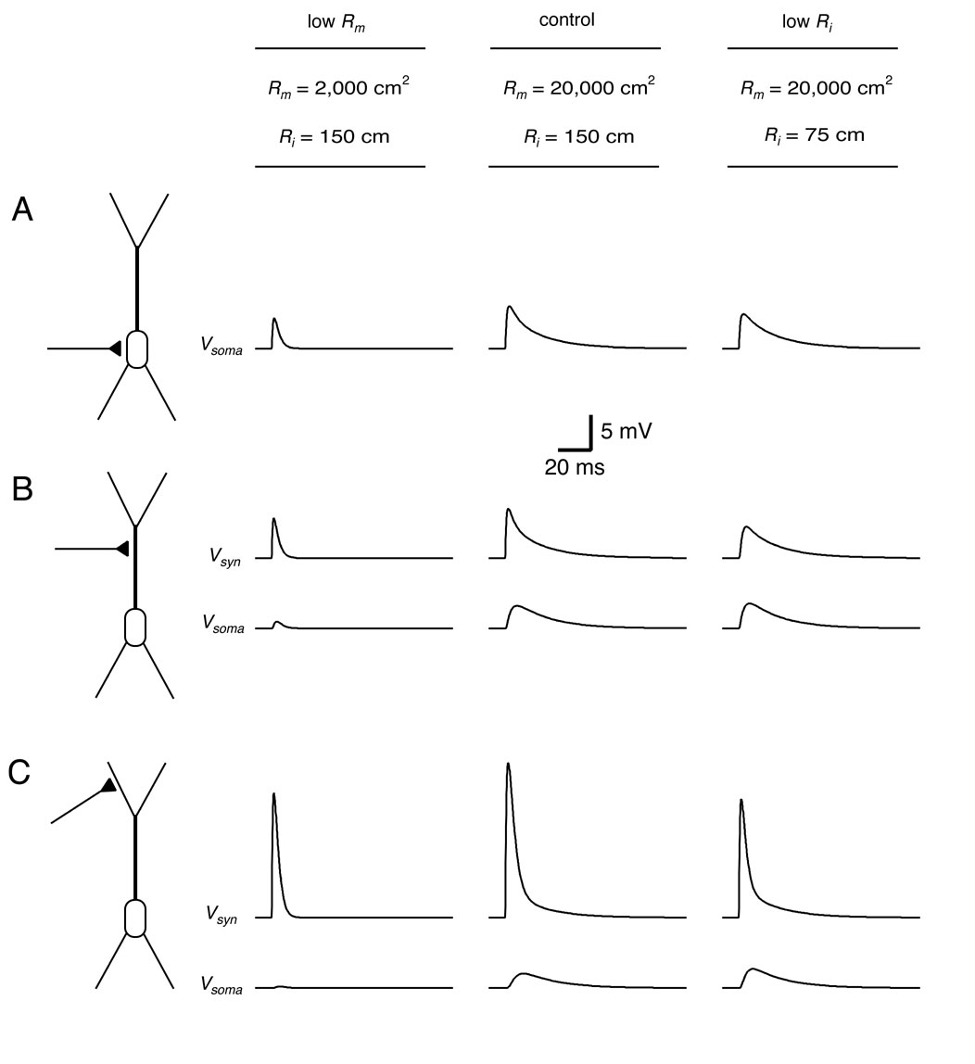
Effects of location, R_{m} and R_{i} on EPSP attenuation

Slide 21
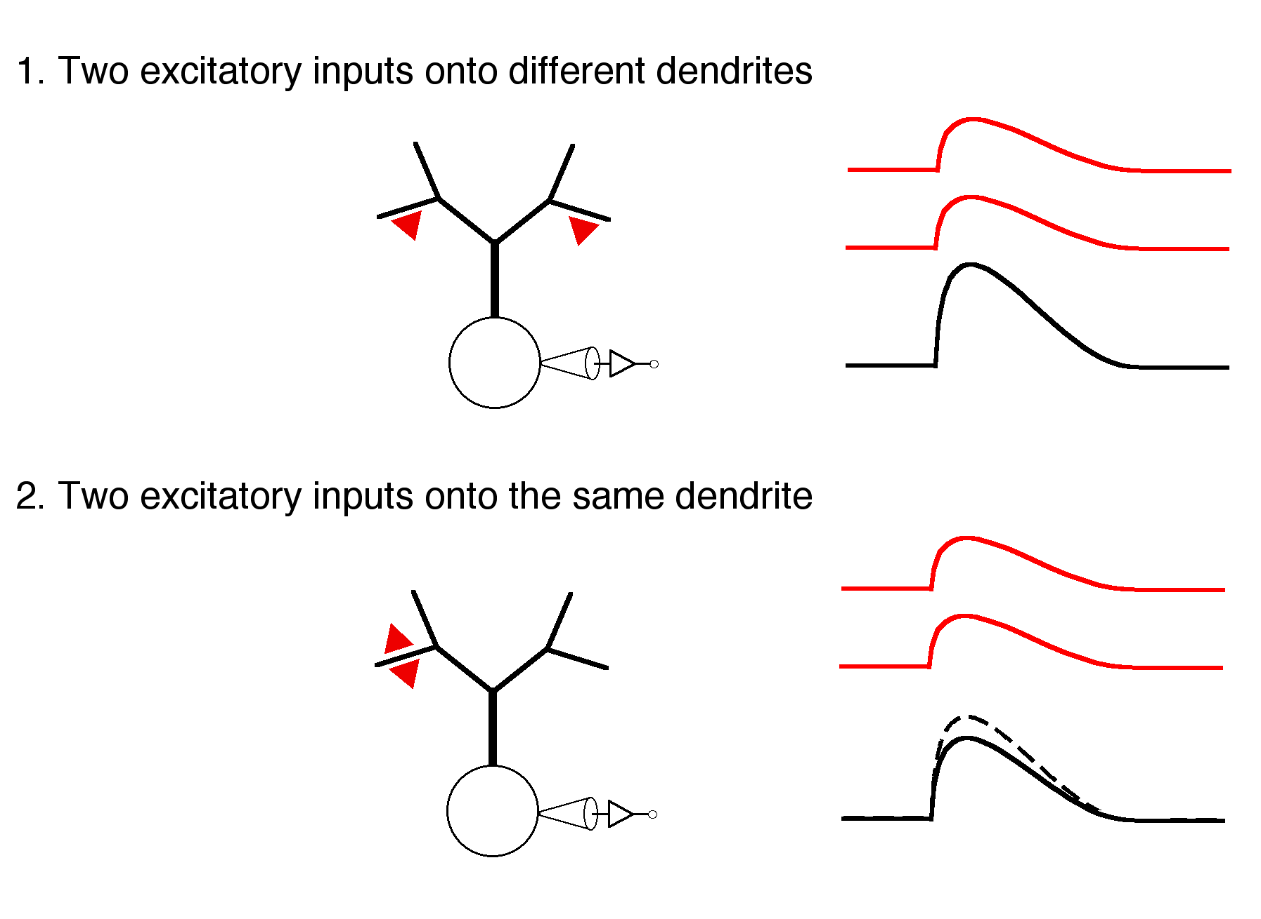
Input-Output function in dendrites
Linear
Sublinear

Slide 22
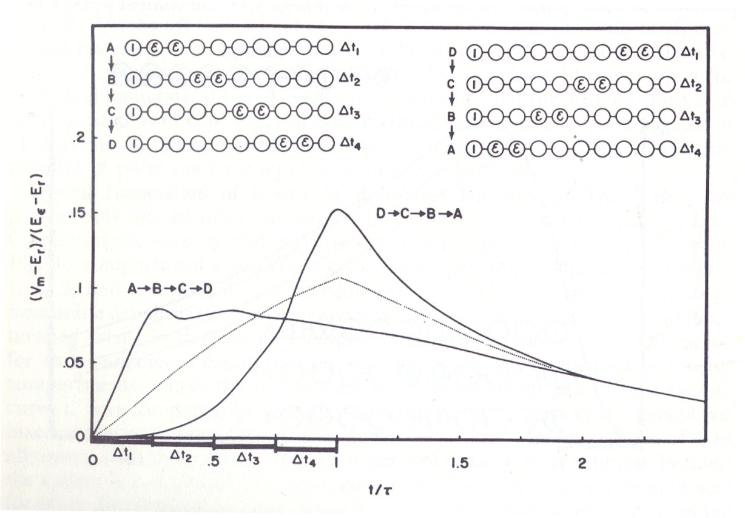
Computation of input direction
Rall, W. 1964

Slide 23
Voltage-gated conductances change IO function
dV
C
=
g_{syn}(V_{syn} – V_{rest})
+ g_{Nav}(V_{Nav} – V_{rest}) + g_{Cav}(V_{Cav} – V_{rest}) + g_{Kv}(V_{kv} – V_{rest})
dt

Slide 24
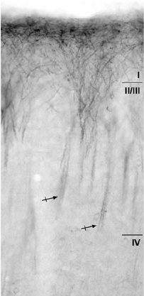
Voltage-gated conductances change IO function
I_{h} channels
Lorincz, A. et al. 2002

Slide 25
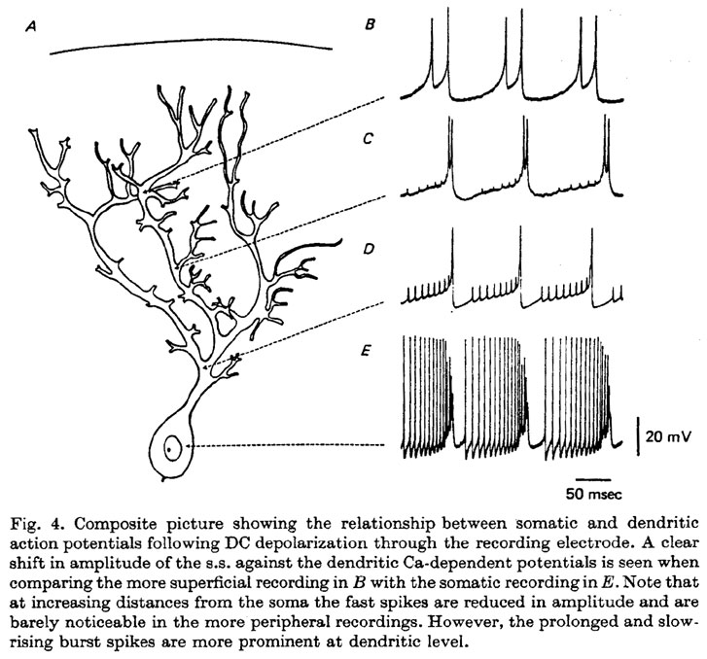
Dendritic Spikes
Ca²⁺ spikes
Na⁺ spikes
from Llinas & Sugimori 1980

Slide 26
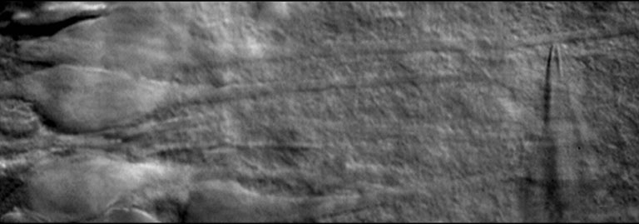
Dendritic patch-clamp recording
Stuart et al.,
Pflüger’s Archiv, 1993
Spruston et al., 1995

Slide 27
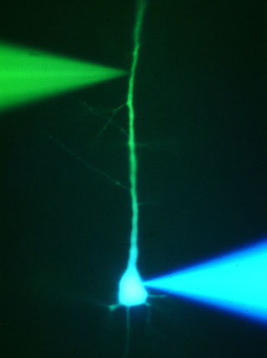
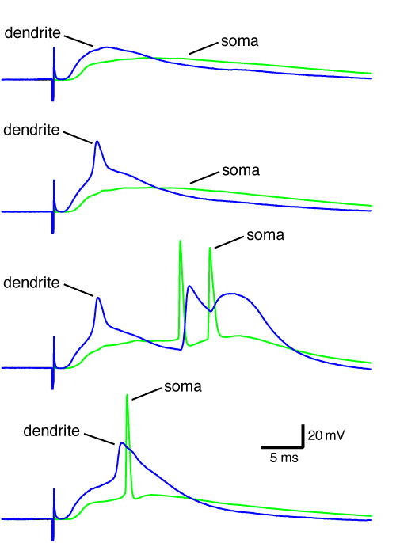
Dendritic Spikes
Neocortical layer 5 pyramidal neurons
Stuart and Sakmann, Nature 1994
Stuart et al, J. Physiol. 1997

Slide 28
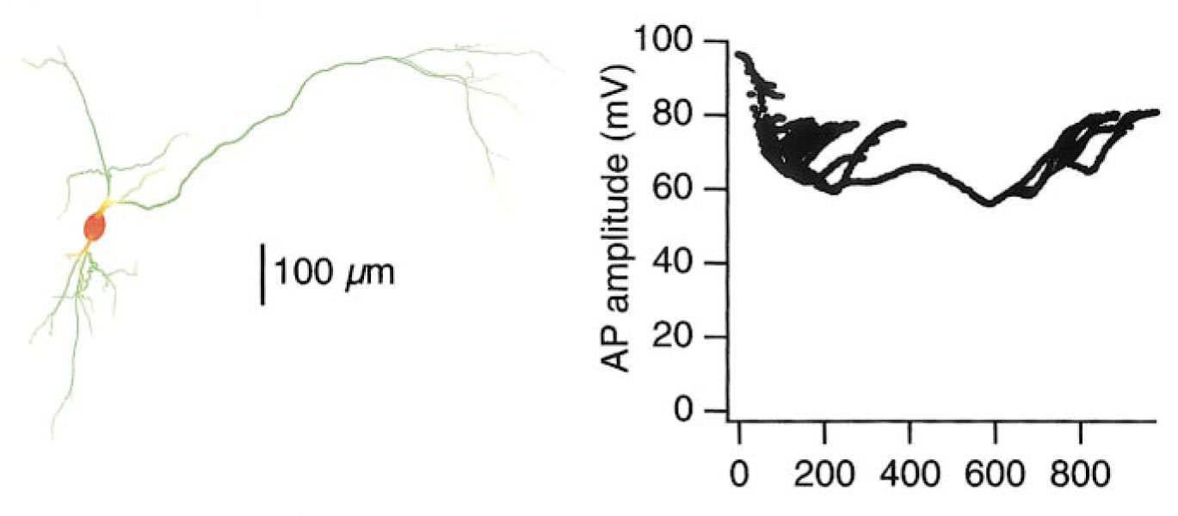
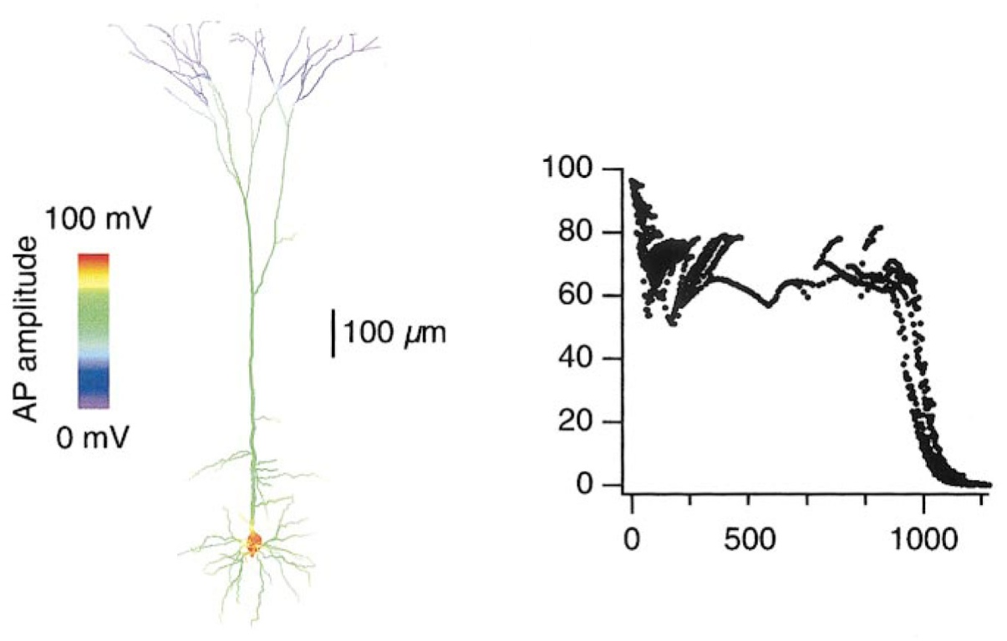
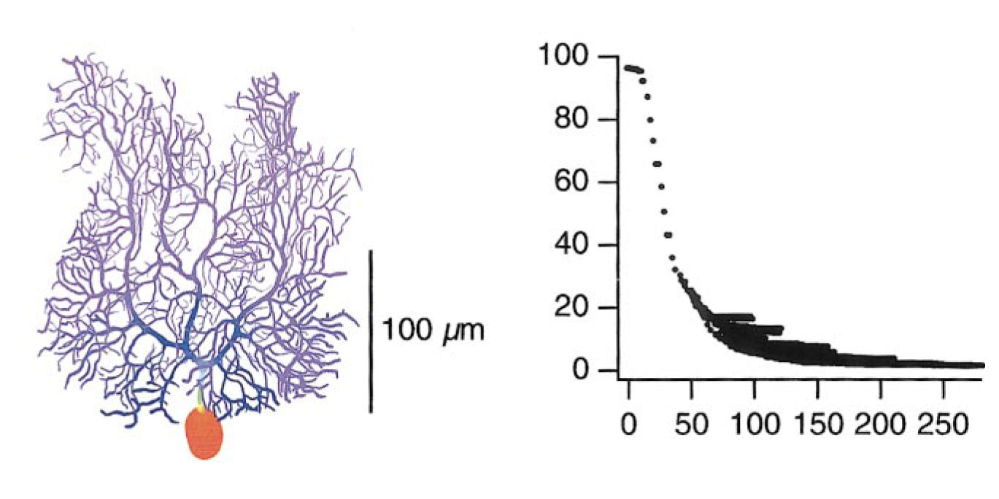
Backpropagating action potentials
Dopamine neurons: high Na channel density and little branching.
Layer 5 pyramidal neurons: moderate Na channel density and moderate branching; more branching in the tuft.
Purkinje neurons: low Na channel density (none in dendrites) and extensive branching.
Distance from soma (µm)
Vetter et al, J. Neurophysiology, 2001

Slide 29
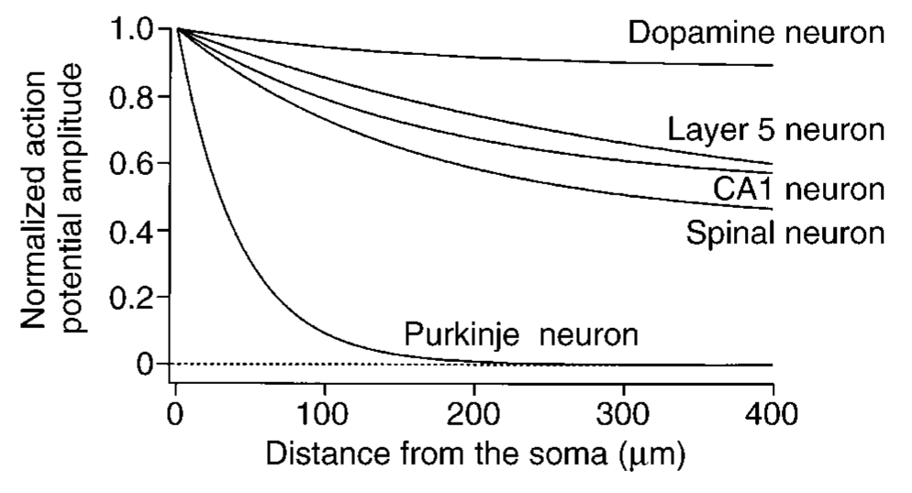
Backpropagating action potentials

Slide 30
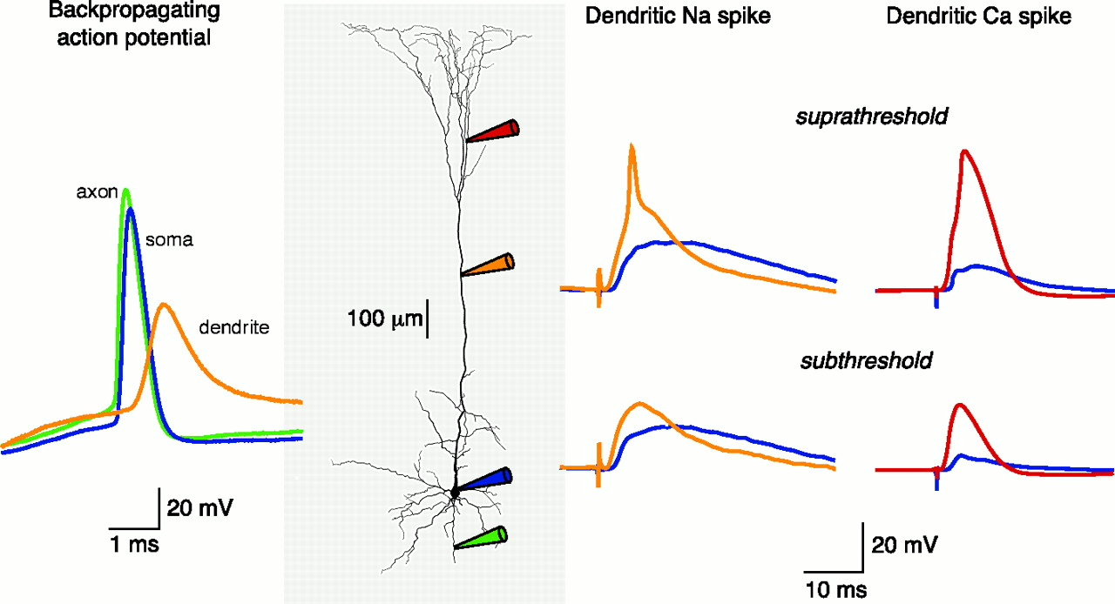
Active properties in dendrites
Hausser, M., Spruston, N. and Stuart, G. 2000

Slide 31
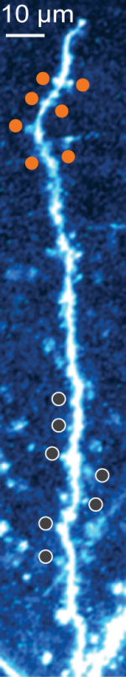
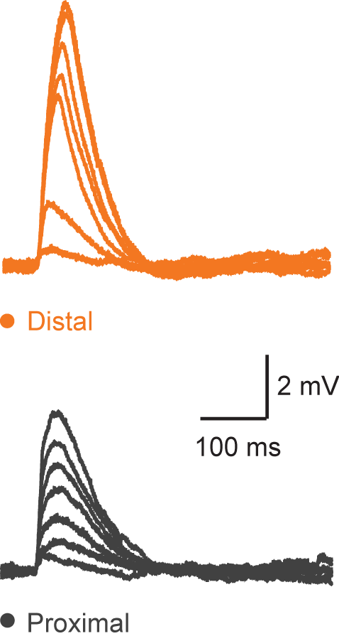
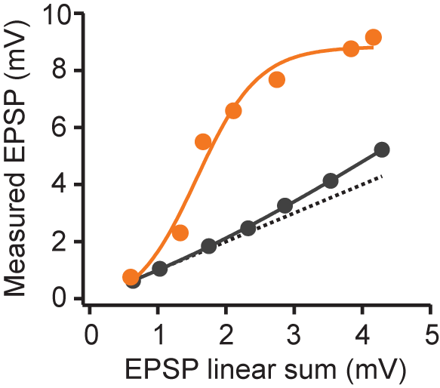
Input-output function varies with dendritic location
Basal dendrite
Input-output function
Branco & Hausser 2011

Slide 32
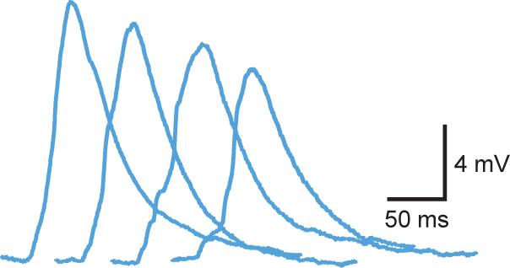

Dendritic computation of input sequences
Patterns
Soma voltage
1
4
5
5
2
1
3
7
A
B
C
D
3
5
1
6
4
2
6
8
5
3
4
3
6
8
8
2
7
6
2
1
8
7
7
4
A
B
C
D
Branco, Clark & Hausser 2011

Slide 33
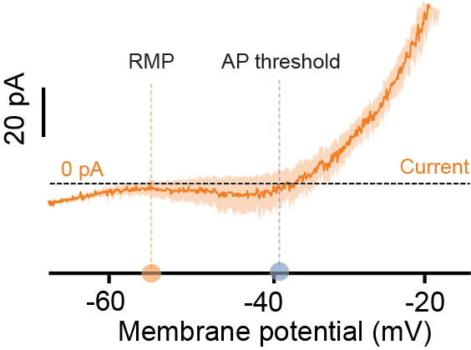
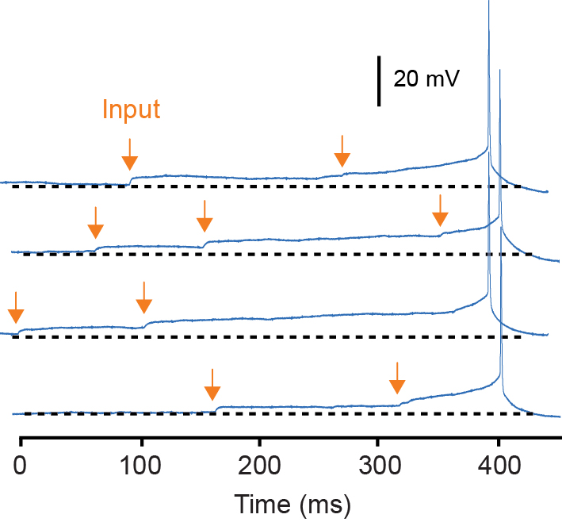
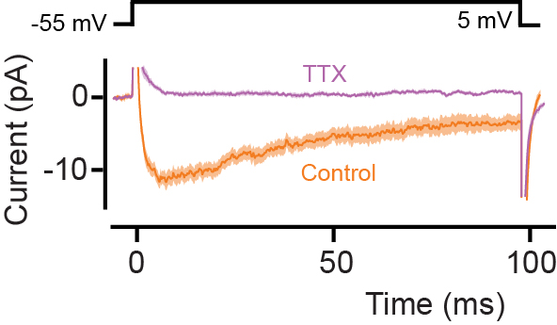
Near-perfect integration
AGRP neurons
Persistent Na current
Branco et al. 2016

Slide 34
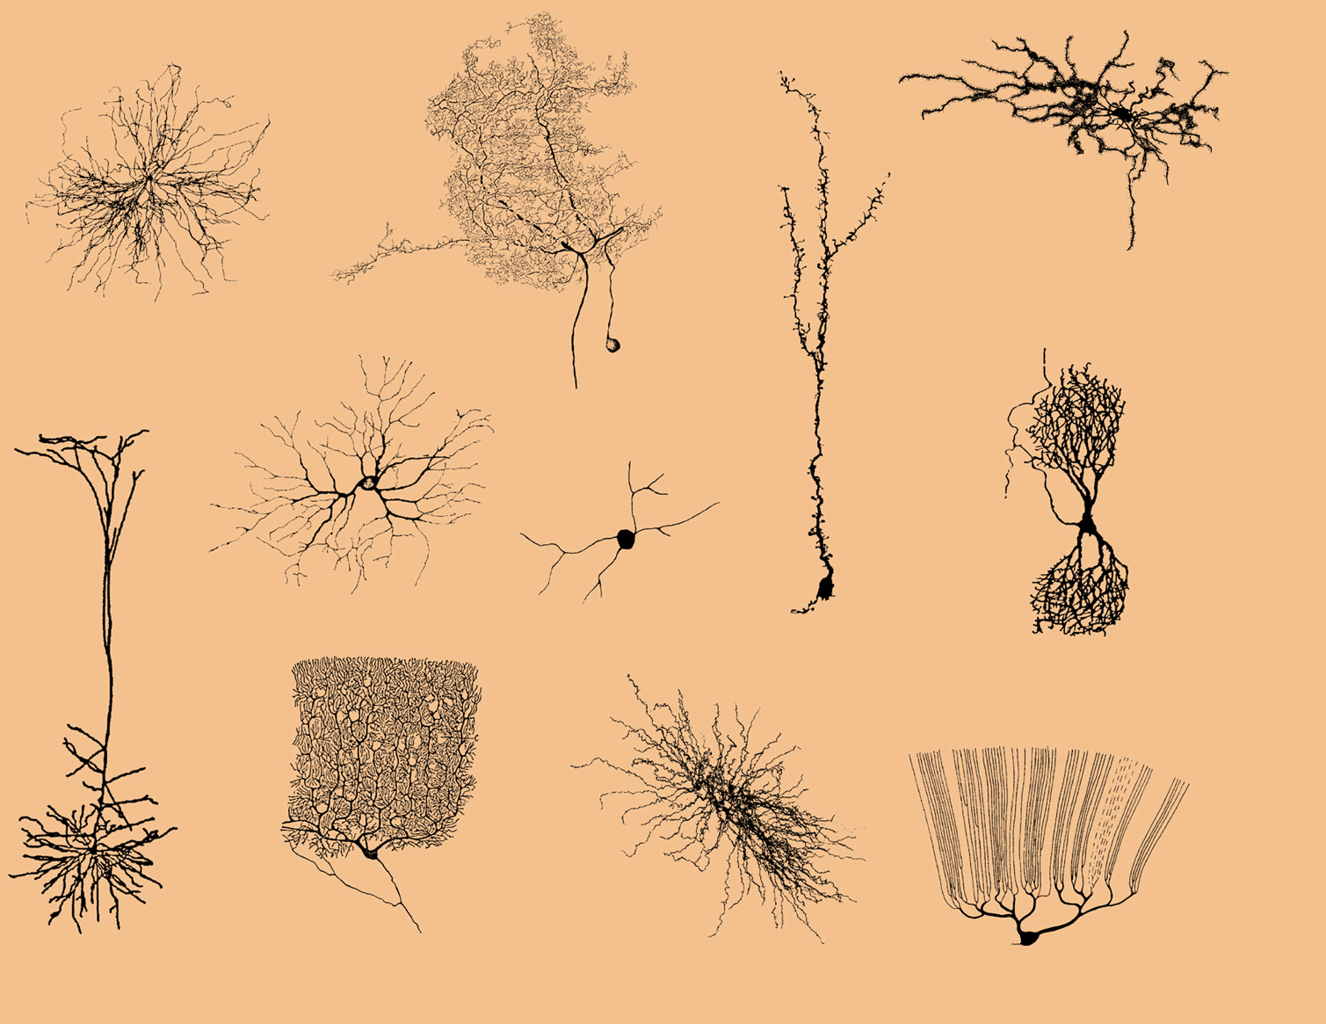

Slide 36
How do we move forward?

Slide 37
Critical step missing
Measure the actual input-output function of a single neuron in vivo
while performing a known computation

Slide 38
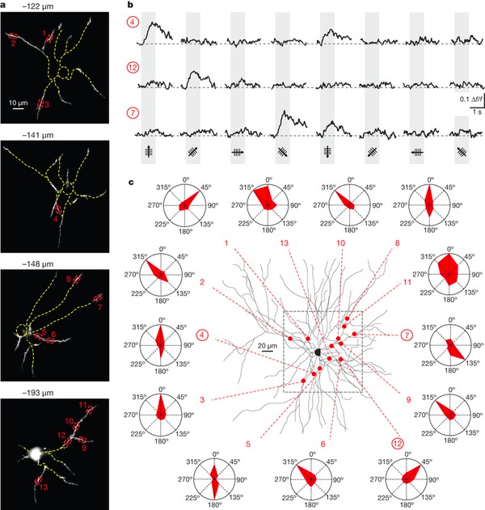
Measuring input-output subsets in the sensory cortex
Jia et al, Nature 2010

Slide 39
Roadmap
Measure input activity in all synapses
Measure sub and supra-threshold output
Formalise the transformation
Identify key ion channels (molecular biology)
Make models and generate predictions about integration
Test predictions and generalise models
Incorporate in network models and tell PEL how the brain works

